Slide 1
CPSC3300: Computer Systems Organization
Lectures 9 & 10 – MIPS Instructions & Datapath

Slide 2
Overview
Elements in the datapath
Program counter (PC)
Instruction memory
ALU
Register file
Data memory
Datapath for various instructions
Reading
Chp4.1-3
Reading: RISC vs. CISC
https://cs.stanford.edu/people/eroberts/courses/soco/projects/risc/risccisc/
MIPS vs ARM
http://www.differencebetween.com/difference-between-mips-and-vs-arm/

Slide 3
Instruction and Data Memories
Cache memory
SRAM device
faster
Low capacity
Expensive
Inside processor chip
Used as cache to hold instructions and data likely to be reused
instruction memory holds instruction
data memory holds data
Main memory
DRAM device
slower
High capacity
Cheaper
Outside processor chip
Used as main memory

Slide 4
RISC vs CISC
RISC: reduced instruction set computing
Register-register type
Fixed instruction size
MIPS, ARM, SPARC, mostly appearing in smart phones, tablet computers
reading: Difference between MIPS and ARM http://www.differencebetween.com/difference-between-mips-and-vs-arm/
CISC: complex instruction set computing
X86, x86_64
Reading: RISC vs. CISC https://cs.stanford.edu/people/eroberts/courses/soco/projects/risc/risccisc/

Slide 5
3 Types of MIPS Instructions
R type: read two registers, write one register
Arithmetic computation
Addition
add $rd, $rs1, $rs2 #$rd ← $rs1 + $rs2
Logical computation
And
and $rd, $rs1, $rs2 #$rd ← $rs1 & $rs2
J type: no register operand
Jump to an address

Slide 6
3 Types of MIPS Instructions
I type: two register operands
Arithmetic computation with immediates (constants)
Read one register, write one register, e.g.,
add $rt, $rs, 10 #$rt ← $rs + 10
Branch: if-else, for, while, switch
Read two registers, e.g,
beq $t0, $t1, Target #branch to Target if $t0 == $t1
Load data from memory or store data to memory
Load: read one register, write one register, i.e.,
lw $8, 12($16) # $8 ← mem($16+12)
Store: read two registers
sw $8, 12($16) # $8 → mem($16+12)

Slide 7
32-bit MIPS Instructions
3 types of instructions, each instruction 32 bits
A total of 32 registers, 5-bit register address
R-type
0
rs
rt
rd
shamt
funct
31:26
25:21
20:16
15:11
10:6
5:0
Load/ Store I-type
35 or 43
rs
rt
address
31:26
25:21
20:16
15:0
Branch I-type
4
rs
rt
address
31:26
25:21
20:16
15:0
opcode
always read
read, except for load
write for R-type and load
sign-extend and add

Slide 8
Instruction Execution on Processors
PC → instruction memory, fetch instruction
Register numbers → register file, read registers
Depending on instruction class
Use ALU to calculate
Arithmetic result
Memory address for load/store
Branch target address
Access data memory for load/store
PC ← target address or PC + 4

Slide 9
Building a Datapath
Datapath
Elements that process data and addresses in the CPU
Registers, ALUs, mux’s, memories, …
We will build a MIPS datapath incrementally
We focus on single-cycle design, which finishes all steps in a single clock cycle

Slide 10
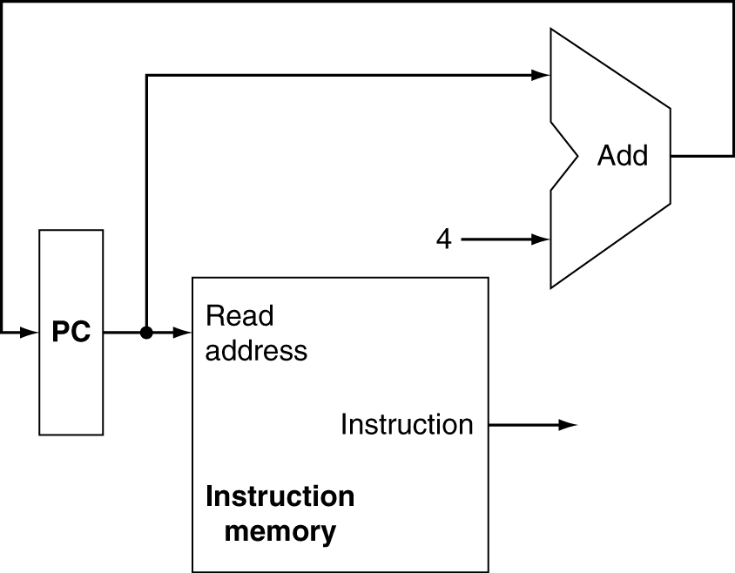
Instruction Fetch
Increment by 4 for next instruction
32-bit register

Slide 11
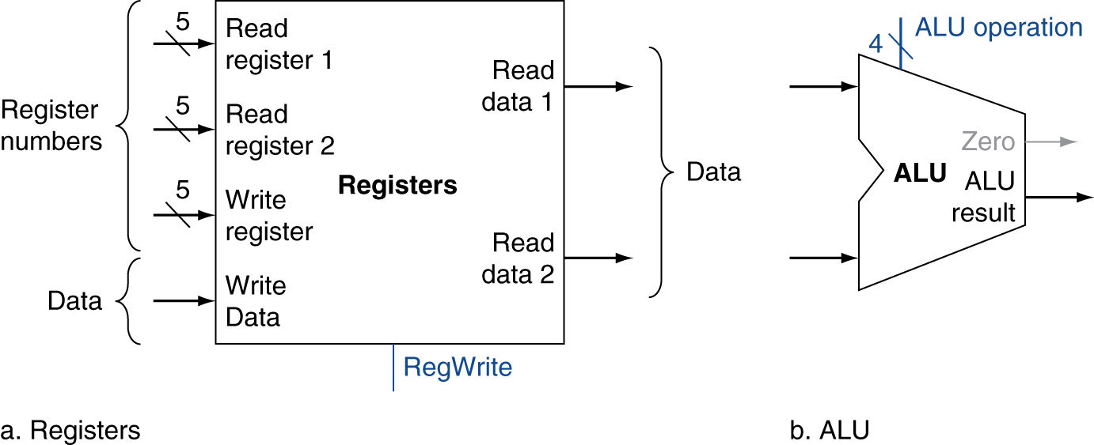
R-Format Instructions
Read two register operands
Perform arithmetic/logical operation
Write register result

Slide 12
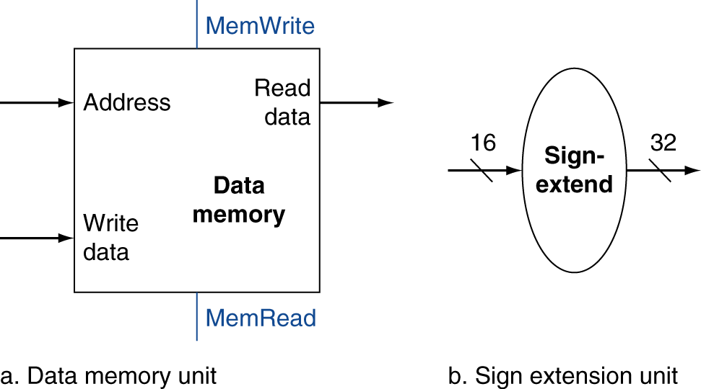
Load/Store Instructions
Read register operands
Calculate address using 16-bit offset (constant)
Use ALU, but sign-extend offset
Load: Read memory and update register
Store: Write register value to memory

Slide 13
Branch Instructions
Read register operands
Compare operands
Use ALU, subtract and check Zero output
Calculate target address
Sign-extend displacement
Shift left 2 places (word displacement)
Add to PC + 4
Already calculated by instruction fetch

Slide 14
Target Addressing Example
Loop code from earlier example
Assume Loop at location (80000)₁₀
Loop: sll $9, $19, 2 | 80000 | 0 | 0 | 19 | 9 | 2 | 0
add $9, $9, $22 | 80004 | 0 | 9 | 22 | 9 | 0 | 32
lw $8, 0($9) | 80008 | 35 | 9 | 8 | 0
bne $8, $21, Exit | 80012 | 5 | 8 | 21 | 2
addi $19, $19, 1 | 80016 | 8 | 19 | 19 | 1
j Loop | 80020 | 2 | 20000
Exit: … | 80024
bne instruction corresponds to a PC value of 80012,
Exit label corresponds to a PC value of 80024,
2x word length (2*4) added to PC value of next instruction (PC+4) when branch taken:
Next instruction: PC+4 (80016), 8 is added and instruction after Exit label will run next

Slide 15
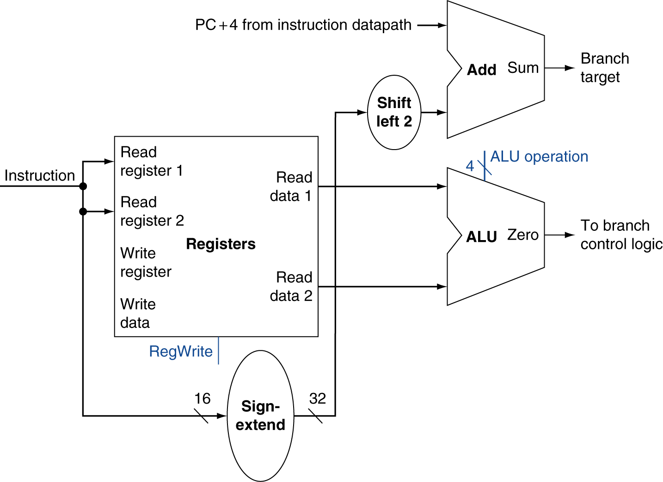
Branch Instructions
Just re-routes wires
Sign-bit wire replicated

Slide 16
Composing the Elements
First-cut data path does an instruction in one clock cycle
Each datapath element can only do one function at a time
Hence, we need separate instruction and data memories
Use multiplexers where alternate data sources are used for different instructions

Slide 17
Single-cycle Instruction execution
R-type
Fetch instruction and increment PC
Read two source registers from register file (set control)
Perform ALU operation on register operands
Write ALU result back to register
Store/Load
Fetch instruction and increment PC
Read one register value from register file (set control)
ALU computes sum of immediate and register value
ALU result used as address to memory
Data from memory written back to register (Load only)
Branch
Fetch instruction and increment PC
Read two source registers from register file (set control)
ALU performs subtract on register operands (target addr computed)
Zero result from ALU determines PC

Slide 18
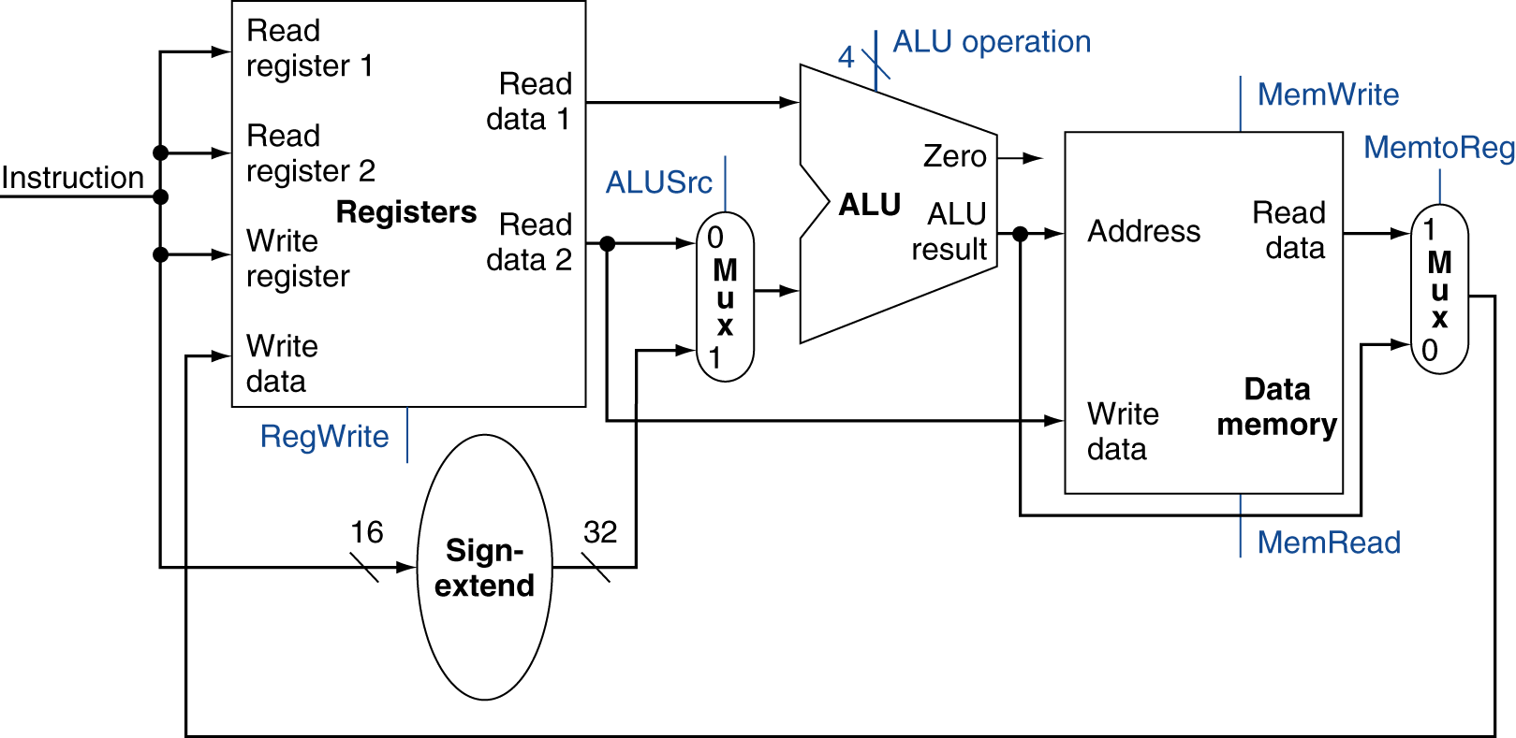
R-Type/Load/Store Datapath

Slide 19
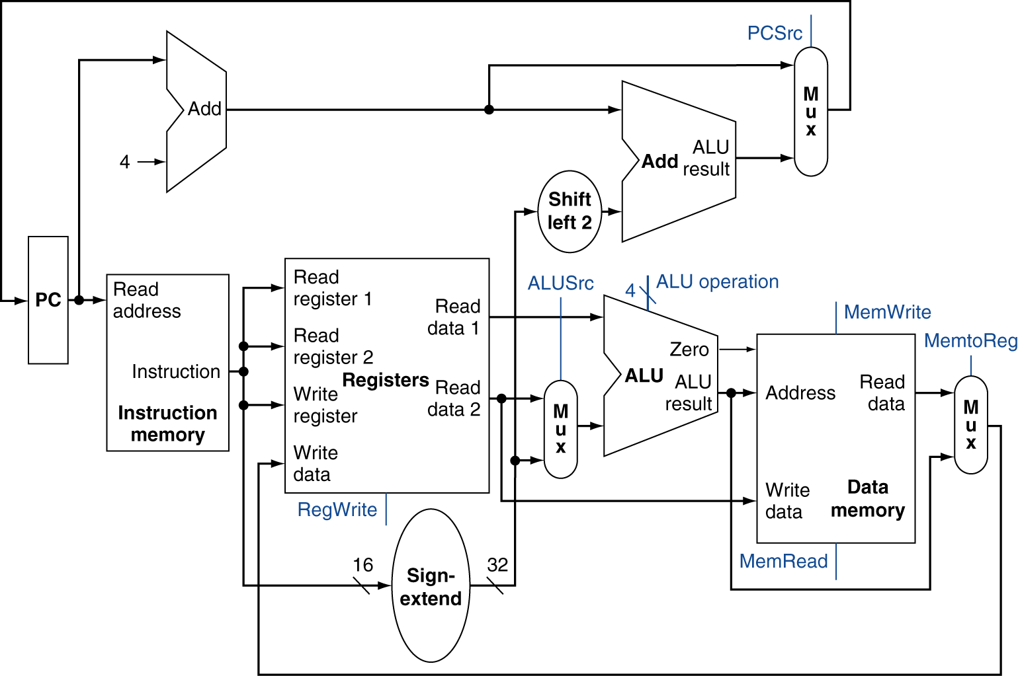
Full Datapath

Slide 20
ALU Control
ALU used for
Load/Store: F = add
Branch: F = subtract
R-type: F depends on funct field
ALU control | Function
0000 | AND
0001 | OR
0010 | add
0110 | subtract
0111 | set-on-less-than
1100 | NOR

Slide 21
ALU Control
Assume 2-bit ALUOp derived from opcode
Combinational logic derives ALU control
opcode | ALUOp | Operation | funct | ALU function | ALU control
lw | 00 | load word | XXXXXX | add | 0010
sw | 00 | store word | XXXXXX | add | 0010
beq | 01 | branch equal | XXXXXX | subtract | 0110
R-type | 10 | add | 100000 | add | 0010
 |  | subtract | 100010 | subtract | 0110
 |  | AND | 100100 | AND | 0000
 |  | OR | 100101 | OR | 0001
 |  | set-on-less-than | 101010 | set-on-less-than | 0111

Slide 22
The Main Control Unit
Control signals derived from instruction
R-type
0
rs
rt
rd
shamt
funct
31:26
25:21
20:16
15:11
10:6
5:0
Load/ Store
35 or 43
rs
rt
address
31:26
25:21
20:16
15:0
Branch
4
rs
rt
address
31:26
25:21
20:16
15:0
opcode
always read
read, except for load
write for R-type and load
sign-extend and add

Slide 23
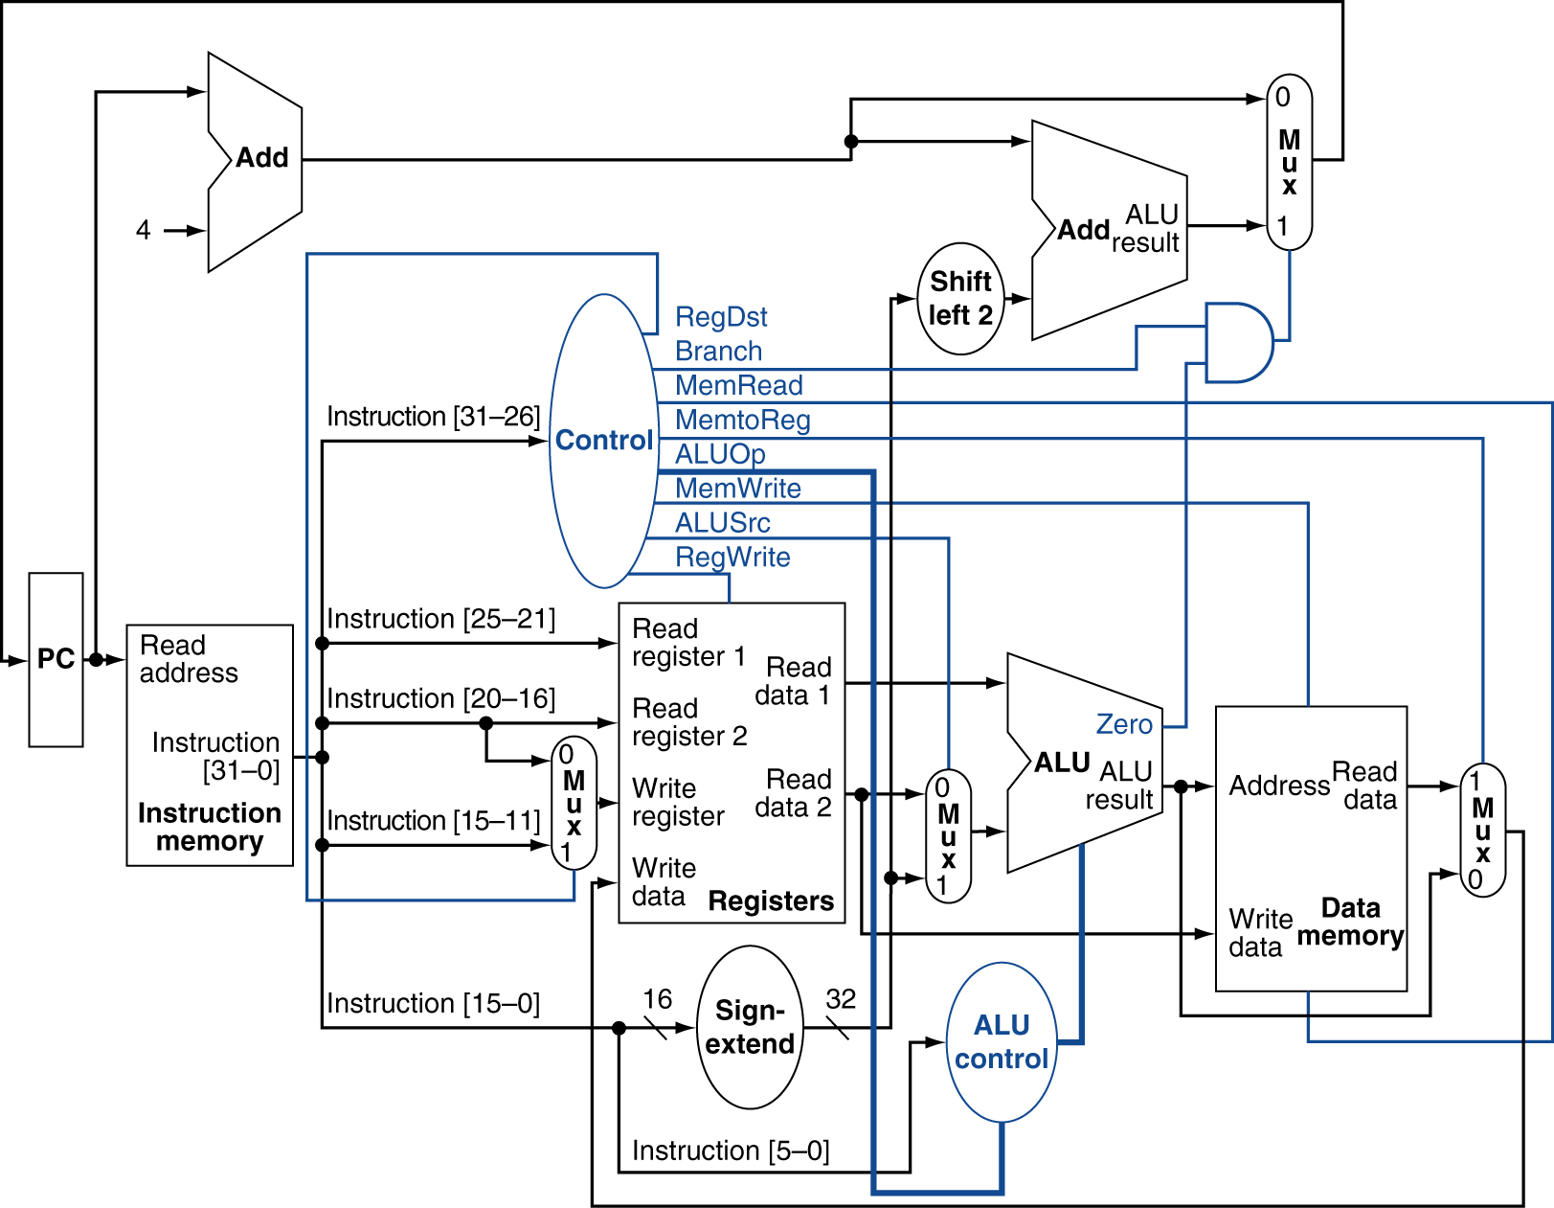
Datapath With Control

Slide 24
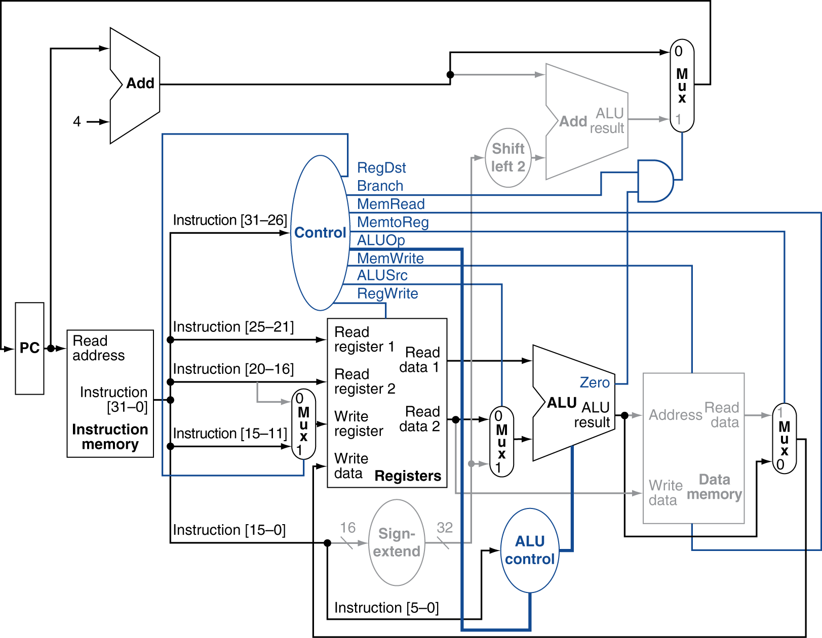
R-Type Instruction

Slide 25
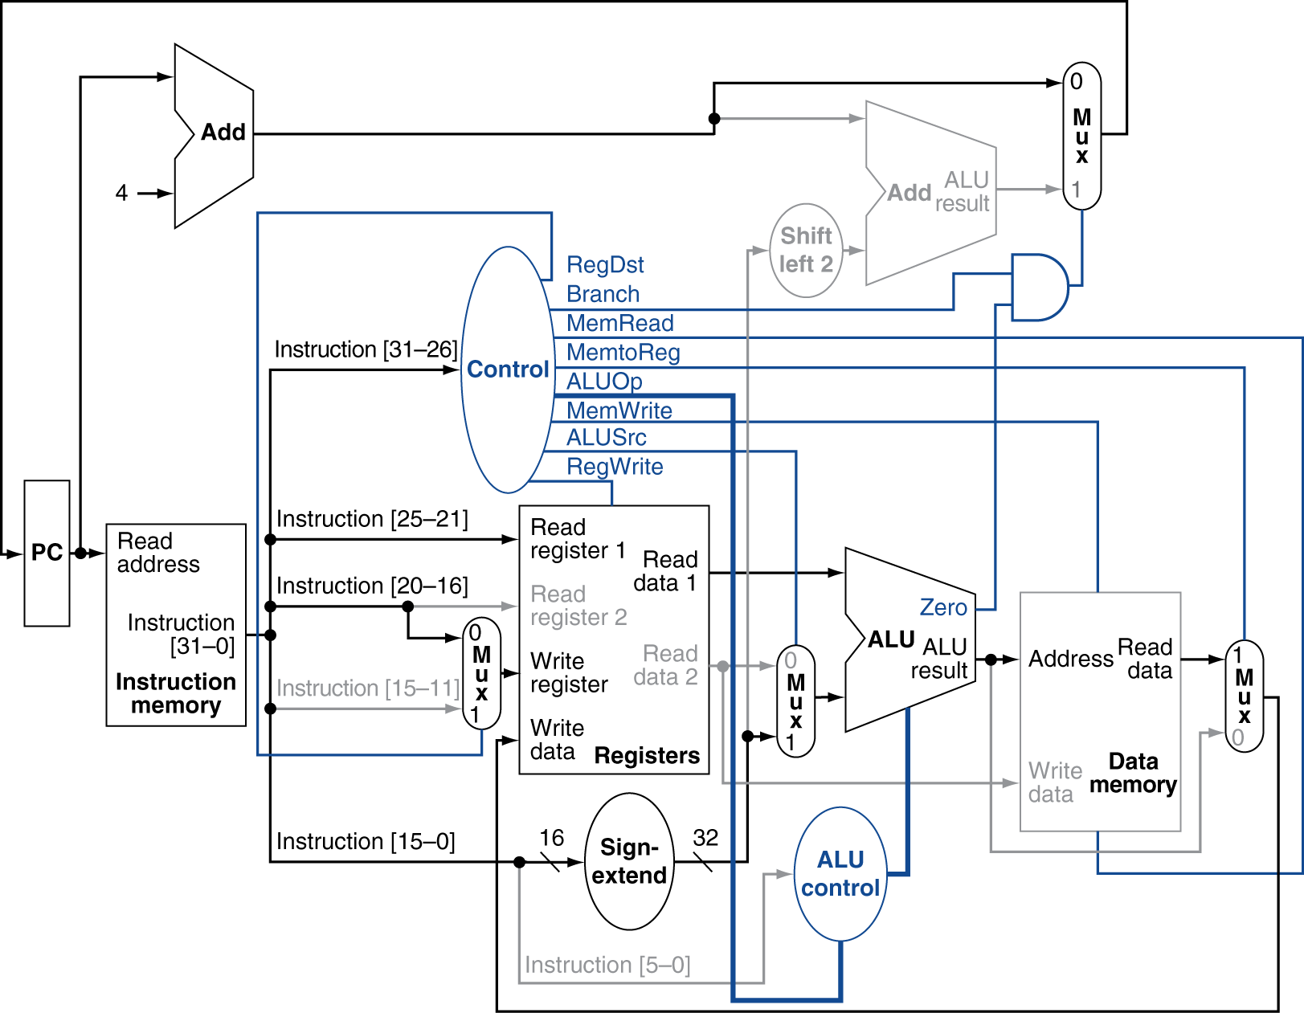
Load Instruction

Slide 26
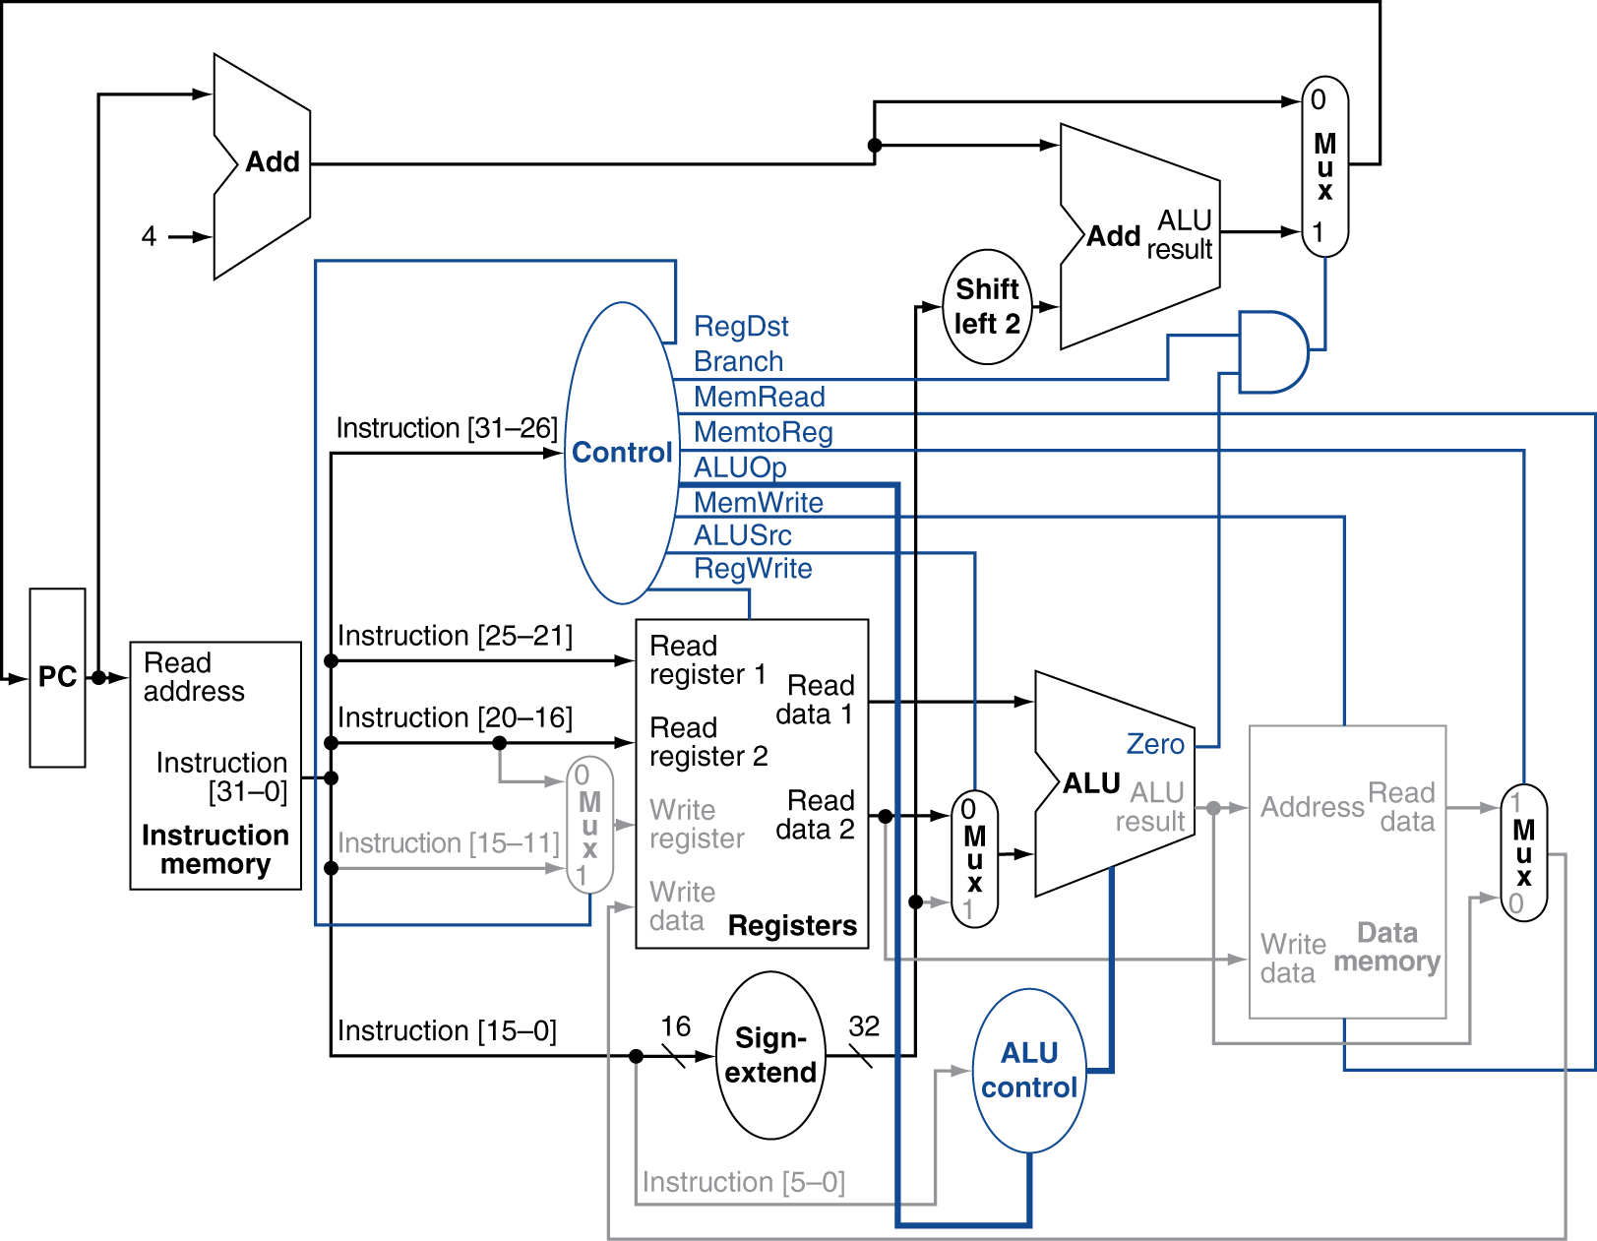
Branch-on-Equal Instruction

Slide 27
Implementing Jumps
Jump
2
address
31:26
25:0
Jump uses word address
Need an extra control signal decoded from opcode
Direct jump addressing
PC: the address of the instruction following the jump
Full target address = PC_{31…28} : (address × 4)
PC_{31…28}
Address
00
4bits
26bits
2bits
Why can we concatenate 00 to the address?

Slide 28
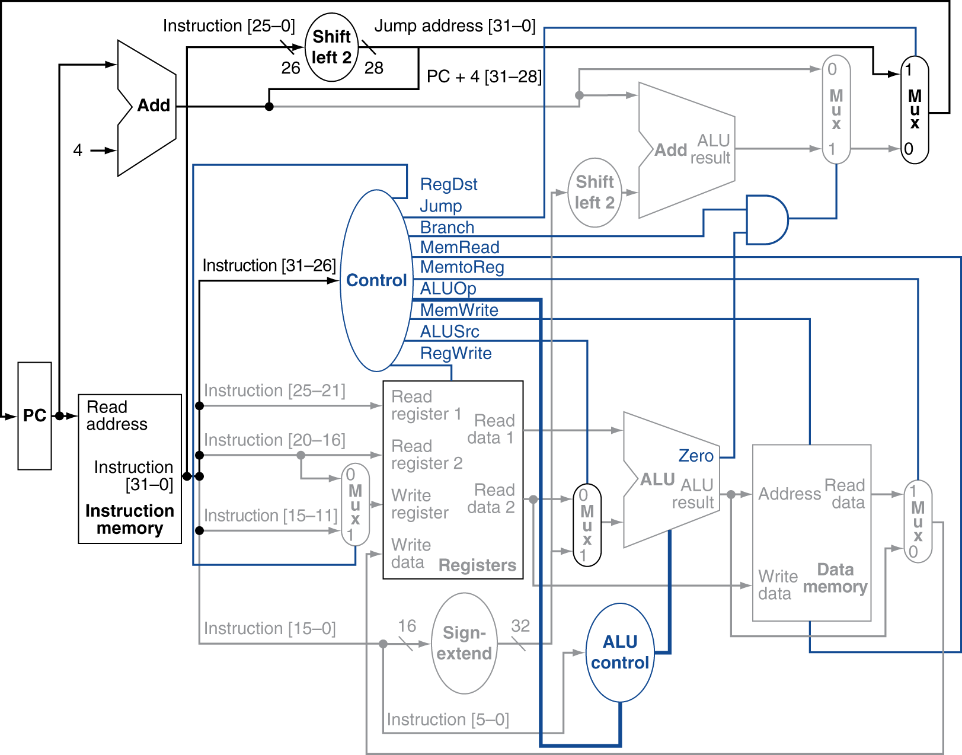
Datapath With Jumps Added

Slide 29
Performance Issues of Single Cycle Datapath
Longest delay determines clock period
Critical path: load instruction
Instruction memory → register file → ALU → data memory → register file
Not feasible to vary period for different instructions
Violates design principle
Making the common case fast
We will improve performance by pipelining

Slide 30
Summary
Elements in datapath
Datapath for R, I, and J types of MIPS32
Control for MIPS32

